Slide 1
Machine Learning DASC 522
Regression Review
Dr. Torrey Wagner

Slide 2
Overview
Big Picture
Regression Fundamentals
Error
Model Building with Python Examples
Iris

Slide 3
Overview
Big Picture
Regression Fundamentals
Error
Model Building with Python Examples
Iris

Slide 4
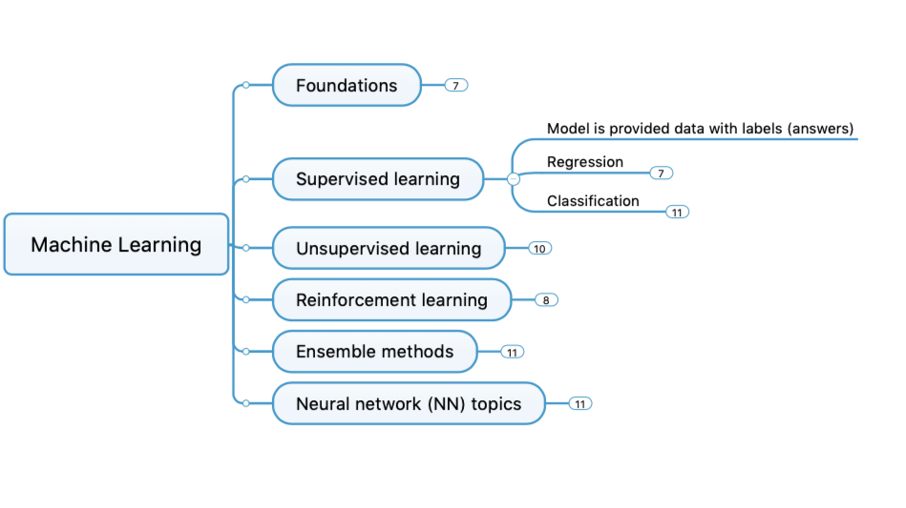
Concept Map

Slide 5
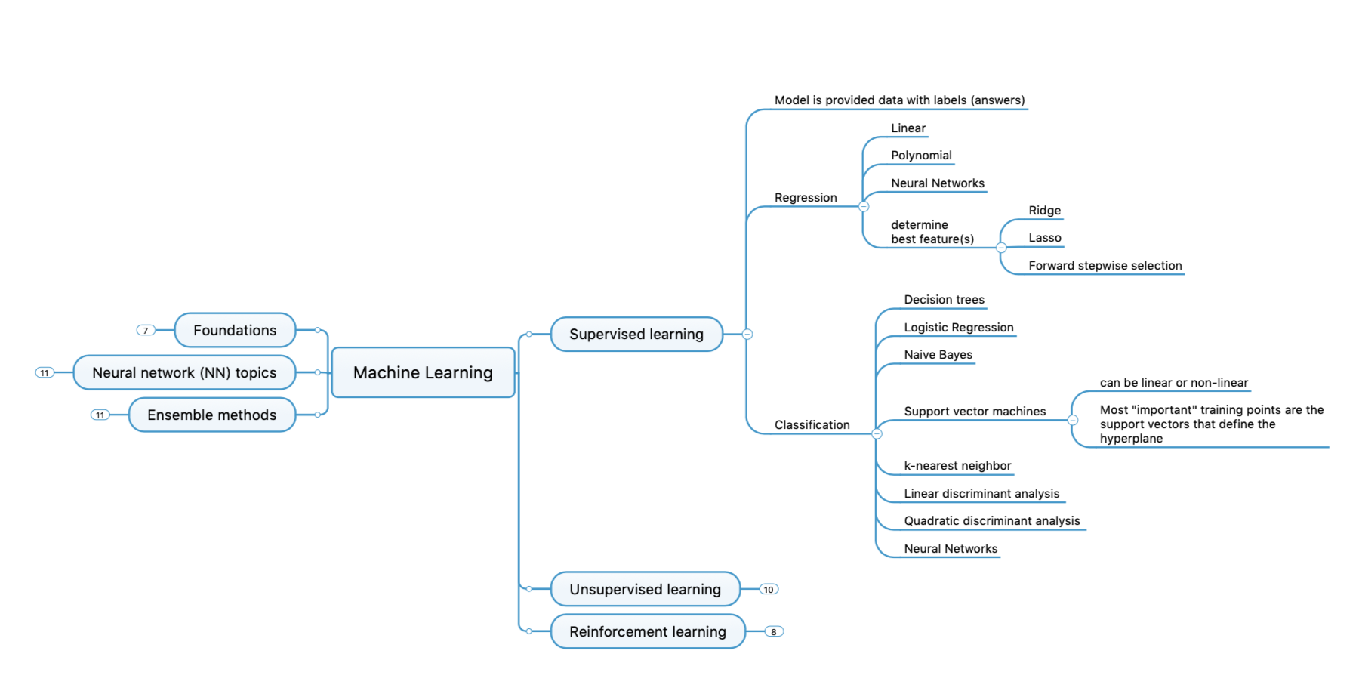
Concept Map - Detailed

Slide 6
Tools & Problems
Type of ML Problem | Description | Example
Classification | Pick one of N labels | Cat, dog, horse, or bear
Regression | Predict numerical values | Click-through rate
Clustering | Group similar examples | Most-relevant documents (unsupervised)
Association rule learning | Infer likely association patterns in data | If you buy hamburger buns, you're likely to buy hamburgers (unsupervised)
Structured output | Create complex output | Natural language parse trees, image recognition bounding boxes
Ranking | Identify position on a scale or status | Search result ranking

Slide 7
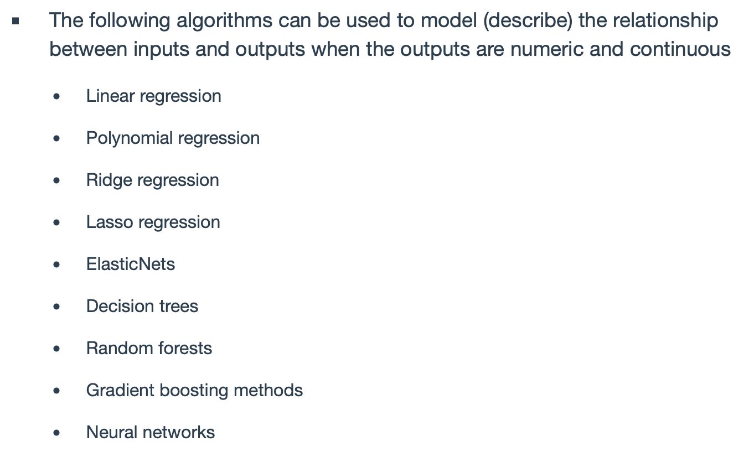
Continuous Problems
Slide from Dr. Jason Freels, AFIT/ENS DASC 500 course

Slide 8
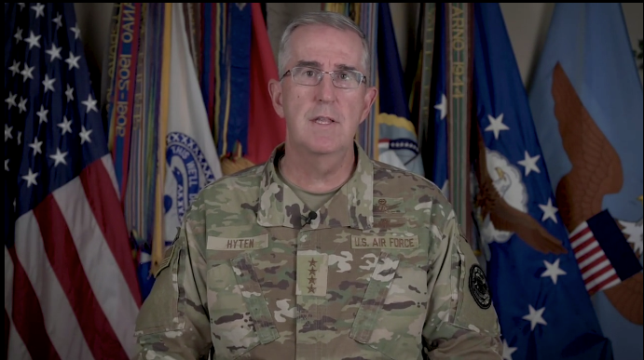
VCJCS AI Overview

Slide 9
Overview
Big Picture
Regression Fundamentals
Error
Model Building with Python Examples
Iris

Slide 10
What is Statistical Learning?
Suppose we observe and for
We believe that there is a relationship between Y and at least one of the X’s.
We can model the relationship as
Where f is an unknown function and ε is a random error with mean zero.
Slide from Dr. Brett Borghetti, AFIT/ENG CSCE 623 Statistical Machine Learning course, 2019SP

Slide 11
A Simple Example
Slide from Dr. Brett Borghetti, AFIT/ENG CSCE 623 Statistical Machine Learning course, 2019SP

Slide 12
A Simple Example
ε_{i}
f
Slide from Dr. Brett Borghetti, AFIT/ENG CSCE 623 Statistical Machine Learning course, 2019SP

Slide 13
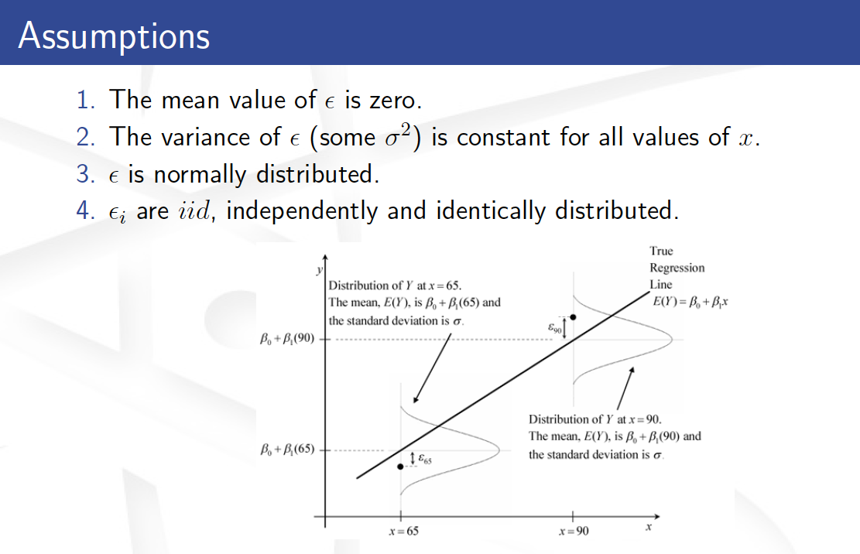
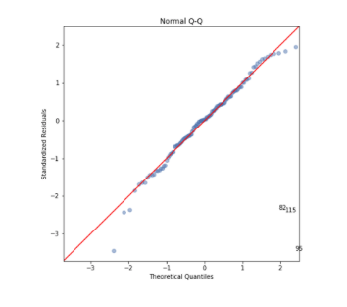
blank

Slide 14
The (multiple) Linear Regression Model
The parameters in the linear regression model are very easy to interpret.
β₀ is the intercept (i.e. the average value for Y if all the X’s are zero), β_{j} is the slope for the j^{th} variable X_{j}
β_{j} is the average increase in Y when X_{j} is increased by one and all other X’s are held constant.
Slide from Dr. Brett Borghetti, AFIT/ENG CSCE 623 Statistical Machine Learning course, 2019SP

Slide 15
Interaction
The effect on Y of increasing X₁ depends on another data feature (e.g. X₂)
Examples
Salaries may go up faster (or slower) depending on how long someone has been at a comopany.
TV and radio advertising both increase sales.
Perhaps due to synergy, spending money on both of them may increase sales more than spending the same amount on one alone?
Slide from Dr. Brett Borghetti, AFIT/ENG CSCE 623 Statistical Machine Learning course, 2019SP

Slide 16
Interaction in advertising
Spending $1 extra on TV increases average sales by 0.0191 + 0.0011×Radio
Spending $1 extra on Radio increases average sales by 0.0289 + 0.0011×TV
Interaction Term TV & Radio together
Slide from Dr. Brett Borghetti, AFIT/ENG CSCE 623 Statistical Machine Learning course, 2019SP

Slide 17
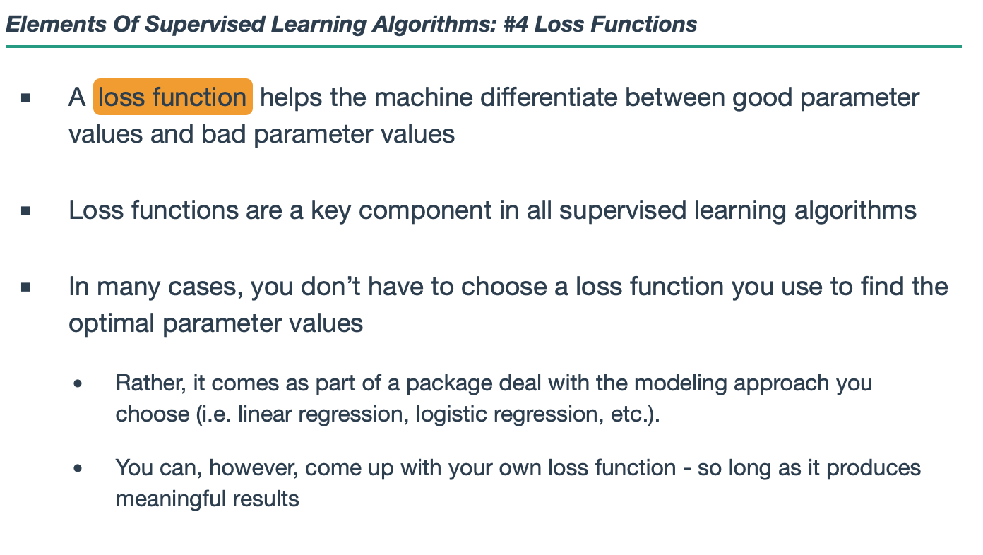
Loss Function

Slide 18
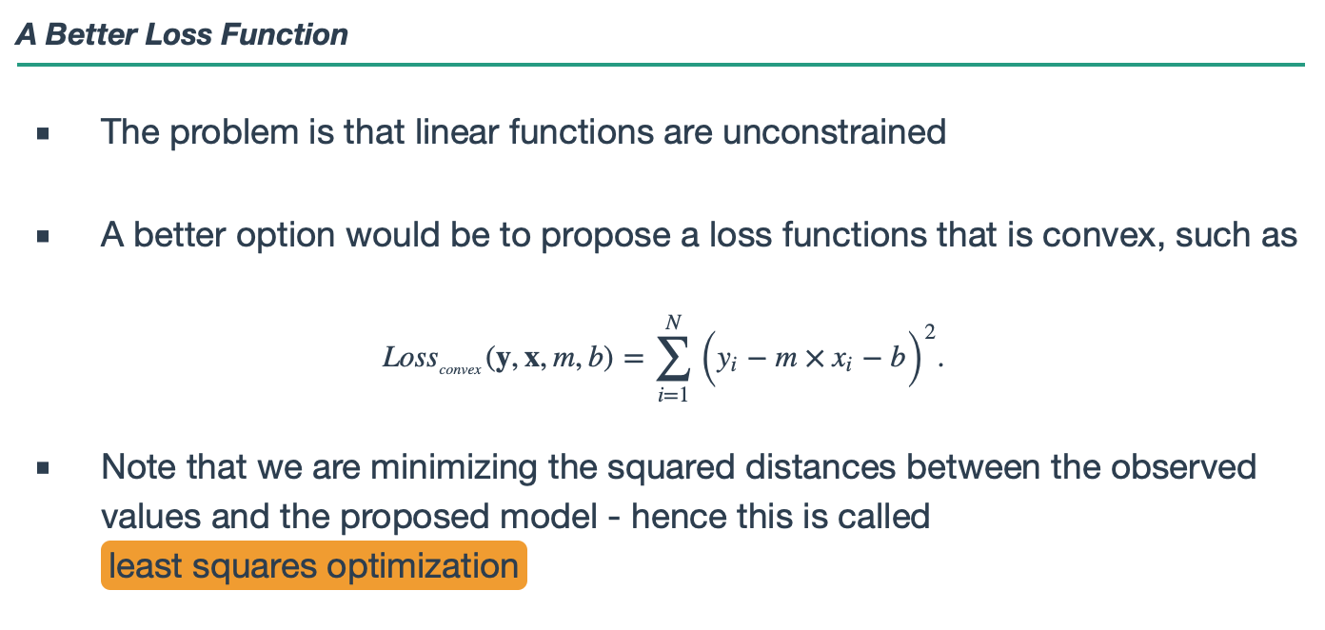
Loss Function

Slide 19
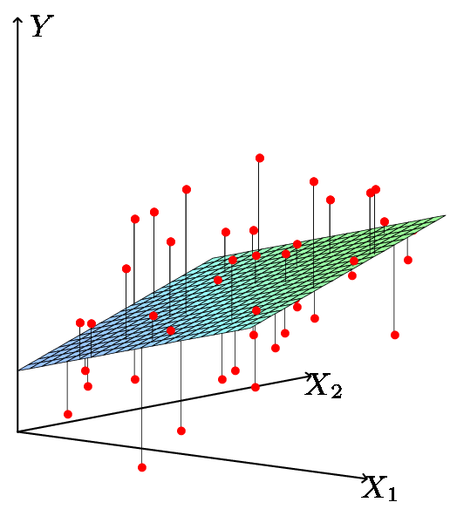
Least Squares Fit
Estimate the parameters using least squares
The best coeff’s are the ones which minimize the cost
Slide from Dr. Brett Borghetti, AFIT/ENG CSCE 623 Statistical Machine Learning course, 2019SP

Slide 20
Overview
Big Picture
Regression Fundamentals
Error
Model Building with Python Examples
Iris

Slide 21
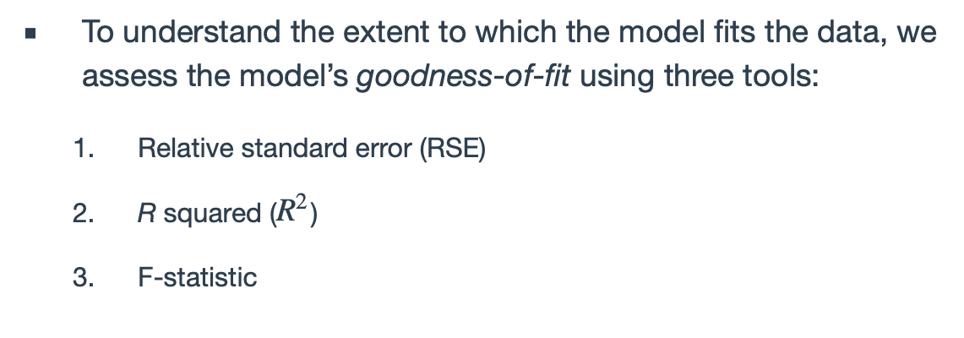
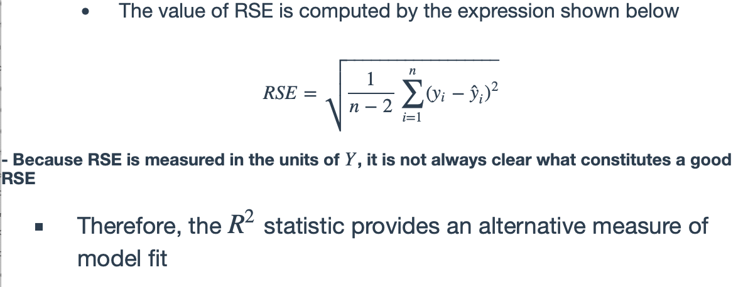
Error

Slide 22
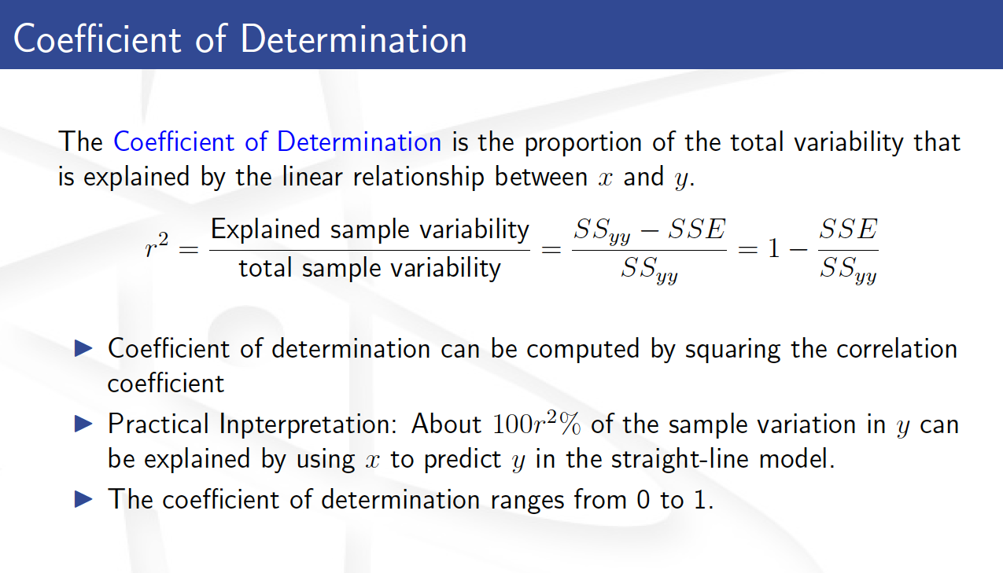
blank

Slide 23
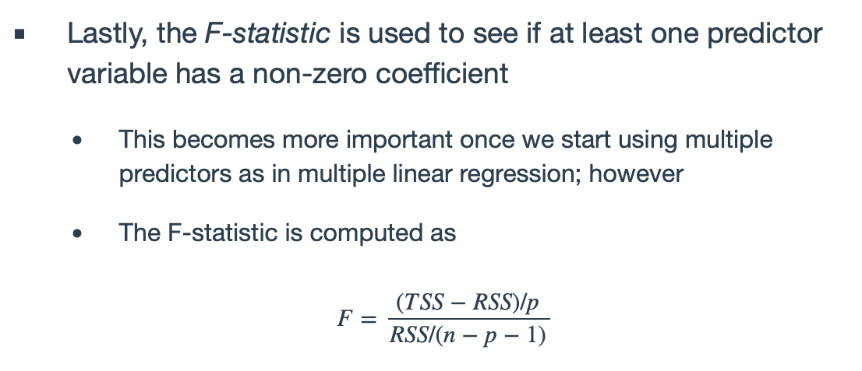
Error

Slide 24
Overview
Big Picture
Regression Fundamentals
Error
Model Building with Python Examples
Iris

Slide 25
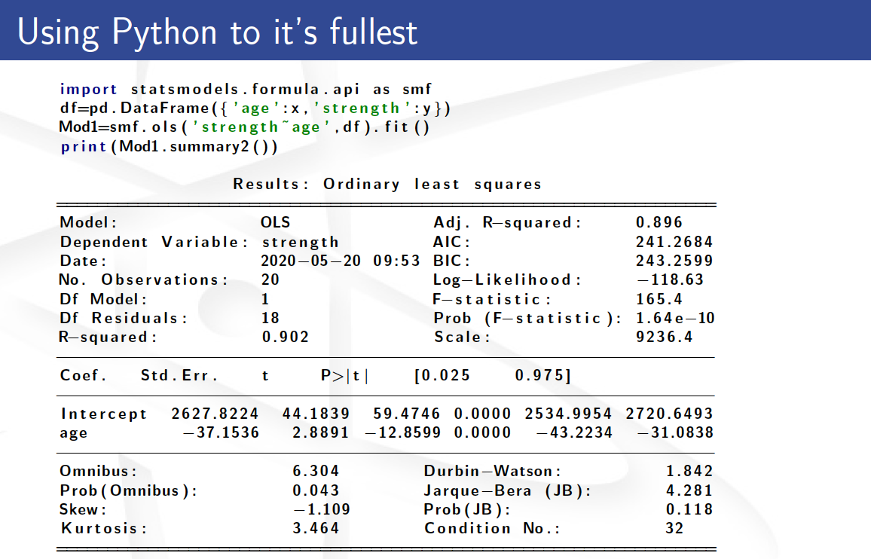
blank

Slide 26
Troubleshooting Potential Fit Problems
There are a number of possible problems that one may encounter when fitting the linear regression model. Fill out the second side of the handout per the instructions
Non-linearity of the data (R2)
Dependence of the error terms (coliniarity – will get a “condition” error)
Non-constant variance of error terms
Outliers
High leverage points
Collinearity
Slide from Dr. Brett Borghetti, AFIT/ENG CSCE 623 Statistical Machine Learning course, 2019SP

Slide 27
Iris Example

